Slide 1
Wildfire Emergency
Prediction System
Group 6
Zachary Venables, Harman Singh, Arun Purayil, Colin Voisard

Slide 2
Problem
Wildfires are growing in both size and frequency
In 2018, there was a total cost of $81 billion in property and asset damage
Wildland firefighters often in rapidly changing situations
Difficult time adjusting resulting in unsafe or ineffective tactics
lead to burnover accidents or the inefficient use of resources
There needs to be a simple way for firefighters, land managers, homeowners and anyone concerned with the behavior of a wildfire to access and analyze wildfire data
Notes:
Harman

Slide 3
Solution
CPS Wildfire Management Tool
Campbell Prediction System
Analyzes weather patterns
Previous wildfire behaviors
Database updates automatically to help algorithm prediction
3D map of the terrain showing current weather and potential wildfire locations

Slide 4
Market
The Forest Product Industry is one of the top industries, generation over $200 billion in sales annually (www.fs.fed.us)​
In 2016 the Forest Product Industry lost between $5.8 billion and $9.8 billion (nvlpubs.nist.gov)

Slide 5
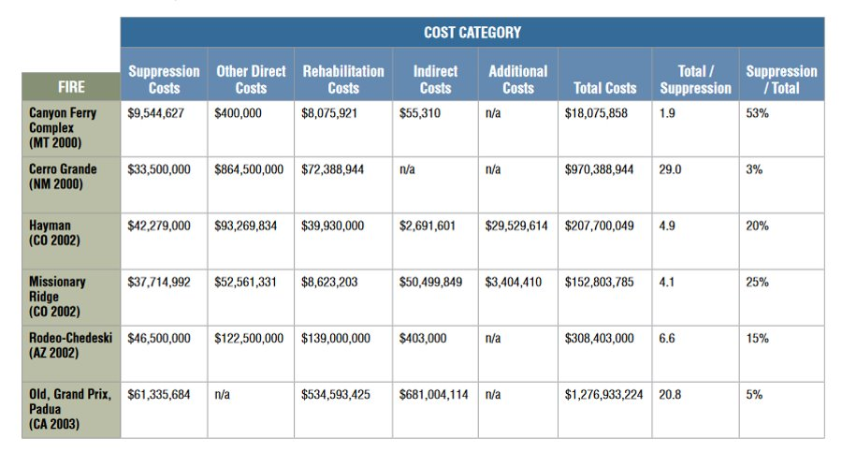
Market
True Cost of Wildfire in the US (www.blm.gov)​
Total cost to US : over $2.9 billion

Slide 6
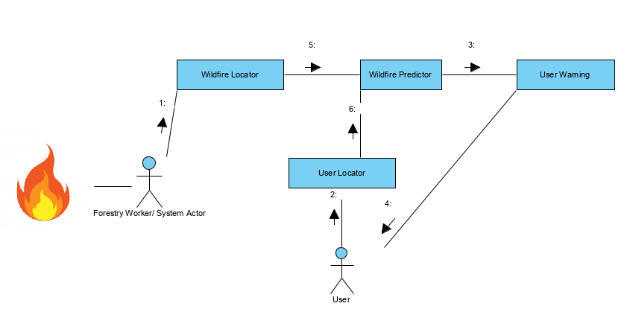
Architecture

Slide 7
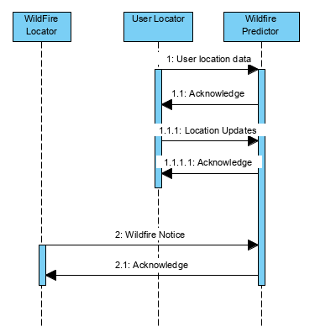
Architecture

Slide 8
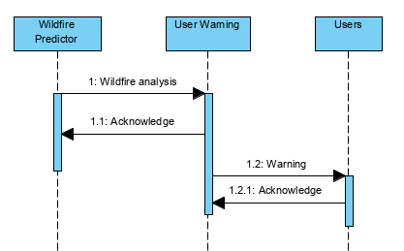
Architecture

Slide 9
Questions?

